Slide 1

INTERNATIONAL UNIVERSITY – VNU HCMC MIDTERM EXAMINATION (2024-2025 S2)
EN012IU SPEAKING AE2
CHALLENGE YOURSELF TO STEP OUT OF THE NORM
Lessons from Khanh Vy Tran (TEDxVinschoolHanoi)
Student name: Phạm Hoàng Tuấn Tú | Student ID: ITCSIU24092
Group 01 – Test room: A2.312
Test date: 12/6/2025

Slide 2


Slide 3

Table Of Contents
Introduction
Reasons/Needs (Why You Should Care)
Implementation (Steps and Mindsets to Apply)
Benefits/Impact (What You Gain)
Conclusion and Call to Action

Slide 4

Quote Khanh Vy: “My parents expected me to have the same path.”

Slide 5
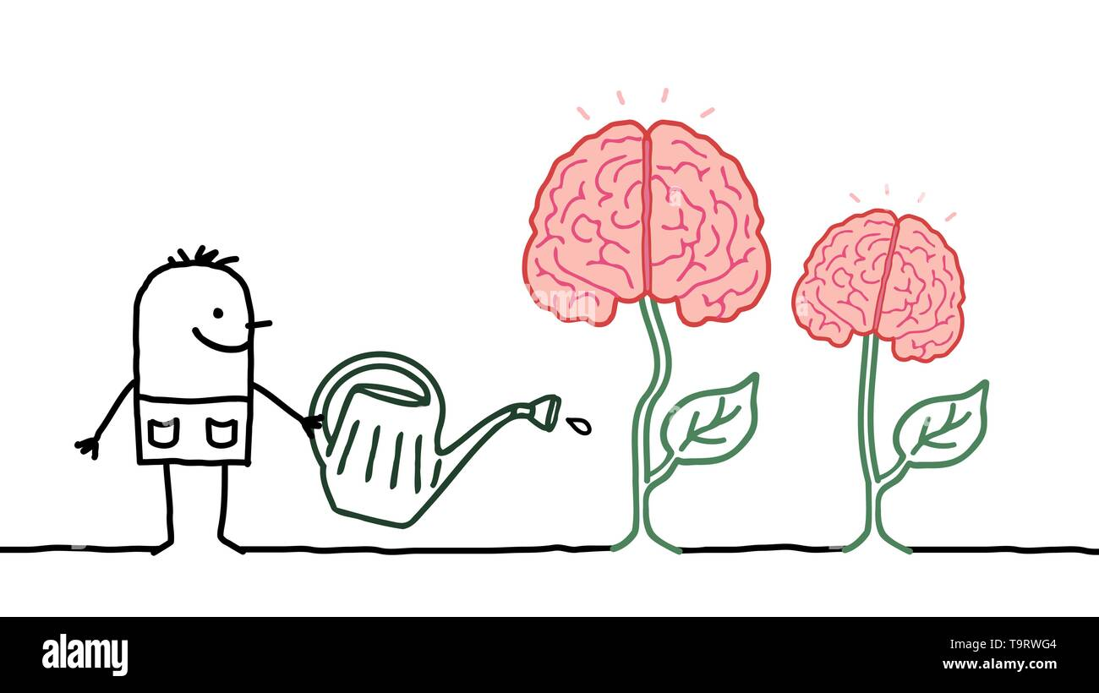

Slide 6


Slide 7

Implementation
Identify your “spark”
Join a club, take a new class, volunteering
“Your unique qualities are strengths – don’t dilute them. Use them to shine.”

Slide 8

Adopt a Growth Mindset
Temporary discomfort means progress
Ask, “What can I learn?” if something does not work out
“You can improve. Every setback is just a setup for a comeback.”

Slide 9



Expand Your Horizons
Try new environments
Learn continuously
Meet new people

Slide 10


Slide 11


Slide 12
References
TEDxVinschoolHanoi: Khanh Vy Tran’s Talk
Harvard Summer School Blog (2024) – Leaving Your Comfort Zone
Cornell Chronicle (2022) – Discomfort and Growth
Psychology Today (2023) – Why Stepping Out Promotes Learning
MSU 4-H Youth Study (2021) – Benefits of Safe Risk-Taking
Verywell Mind (2023) – Erikson’s Psychosocial Theory: Identity Stage

Slide 13
Thank you

